Slide 1
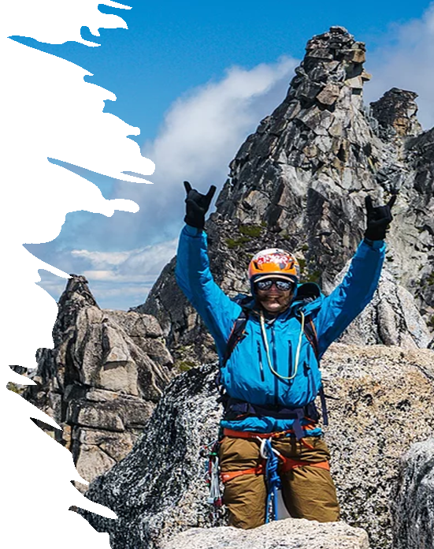
LEVERS
These ppt slides have been designed to allow you to read the question, think about the responses and then on the next ‘click’ the answer will appear. Keep ‘clicking’ your way through all ten slides.
You should allow a maximum of 1 minute per slide, keep an eye on the timer provided.
Make sure you focus on the key words in the question and if any visual stimulus material (graphs, tables, etc) are provided, to understand what is being represented before considering the 4 responses provided.

Slide 2
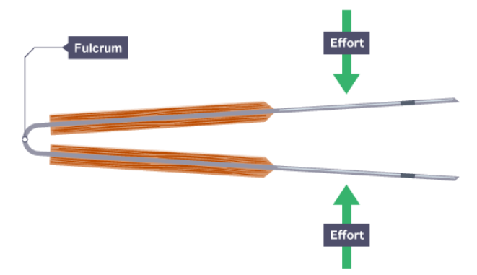
LEVERS
1. These tongs were used to pick up and turn a sausage on the BBQ, and they represent which class of lever:
A. 1st
B. 2nd
C. 3rd
D. 4th
ANSWER : C

Slide 3
LEVERS
2. As the load/resistance is moved further away from the axis/fulcrum, the amount of force required to move the load:
A. Increases
B. Decreases
C. Remains the same
D. Is inversely proportional to the distance the load is moved.
ANSWER : A

Slide 4
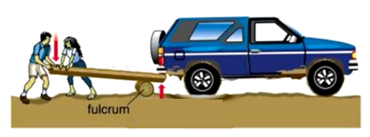
LEVERS
3. Toby and Charlotte have bogged their SUV whilst camping. They use their knowledge of levers to position 2 logs in an effort to lift the vehicle and clear it from the muddy bog. Use the image to determine the type of lever they create:
A. 1st
B. 2nd
C. 3rd
D. 4th
ANSWER : A

Slide 5
LEVERS
4. In the diagram below, the mechanical advantage is:
A. <1
B. =1
C. >1
D.  1
ANSWER : C

Slide 6
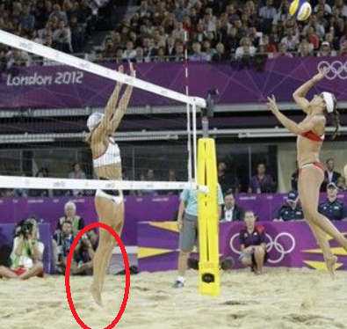
LEVERS
5. The image shows the player on the left of the net pushing off the sand to perform a block. In the circled section, the middle component/part of the lever created is the:
A. Fulcrum (toes)
B. Fulcrum (ankle)
C. Load (body weight)
D. Effort (gastrocnemius)
ANSWER : C

Slide 7
LEVERS
6. When considering levers, the mechanical advantaged can be increased by:
A. Moving the axis/fulcrum further away from the point where the force/effort is being applied
B. Increasing the amount of force that is applied away from the load/resistance
C. Positioning load/resistance an equal distance from the force
D. Resistance arm is greater than the force arm
ANSWER : A

Slide 8
LEVERS
7. Greatest speed can be generated when applying the same force in the following lever system:
A. 1st
B. 2nd
C. 3rd
D. 4th
ANSWER : A

Slide 9
LEVERS
8. In the human body, the effort/force can be located:
A. Equidistant from the point of resistance
B. Where the greatest amount of muscle mass is located
C. At the point where a muscle inserts
D. Exactly where the greatest movement occurs
ANSWER : C

Slide 10
LEVERS
9. The following is an example of a 1st class lever system in the human body:
A. Knee extension : example = seated quad leg extension
B. Knee flexion : example = lying hamstring leg curl
C. Elbow extension : example = tricep extension with kettle bell
D. Elbow flexion : example = bicep curl with barbell
ANSWER : C

Slide 11
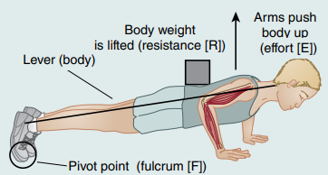
LEVERS
10. Performing a push-up as in the image below represents the following type of lever system:
A. 1st
B. 2nd
C. 3rd
D. 4th
ANSWER : B

