Slide 1
SKILL COACHING, PRACTICE & FEEDBACK
These ppt slides have been designed to allow you to read the question, think about the responses and then on the next ‘click’ the answer will appear. Keep ‘clicking’ your way through all ten slides.
You should allow a maximum of 1 minute per slide, keep an eye on the timer provided.
Make sure you focus on the key words in the question and if any visual stimulus material (graphs, tables, etc) are provided, to understand what is being represented before considering the 4 responses provided.

Slide 2
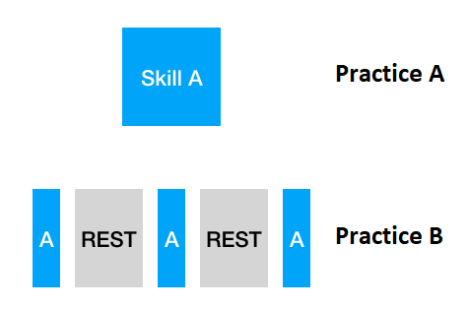
SKILL COACHING, PRACTICE & FEEDBACK
1. By referring to the image below, “Practice B” would best be described as:
A. Massed
B. Blocked
C. Distributed
D. Random
ANSWER : C

Slide 3
SKILL COACHING, PRACTICE & FEEDBACK
2. The following type of feedback would be least useful for someone at the cognitive stage of learning:
A. Visual
B. Augmented
C. KOP (Knowledge of Proprioception)
D. Intrinsic
ANSWER : D

Slide 4
SKILL COACHING, PRACTICE & FEEDBACK
3. Coaches wanting to best simulate game settings for performers at the associative stage are more likely to use the following type of practice:
A. Random
B. Blocked
C. Part
D. Whole
ANSWER : A

Slide 5
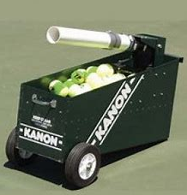
SKILL COACHING, PRACTICE & FEEDBACK
4. Carlos Moya is Rafael Nadal’s coach and in an effort to improve his volleys from the mid-court sets the tennis cannon to randomly launch a short ball which Nadal must follow into the net and then the ball it launched left, central or right by the ‘kanon’. This is an example of a:
A. Individual constraint
B. Singles constraint
C. Task Constraint
D. Environmental constraint
ANSWER : C

Slide 6
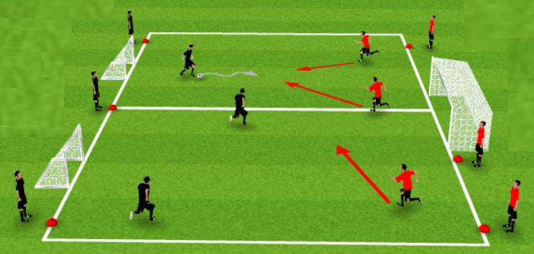
SKILL COACHING, PRACTICE & FEEDBACK
5. A coach decides to set up multiple 3-on-3 ‘keepings off’ and scoring drill as part of a modified soccer training session. Compared to training on a full-sized soccer pitch, players would experience:
A. Lower skill development due to
higher rates of fatigue
B. Higher skill frequencies and associated
skill improvement
C. Better team cohesion
D. Difficulty transferring what they have
practiced to the full-sized pitch
ANSWER : B

Slide 7
SKILL COACHING, PRACTICE & FEEDBACK
6. When coaching tennis players who have just taken up the sport for the first time, the most effective type of feedback would be:
A. Given at the end of the training session to avoid too much to process
B. Only focus on positives to maintain high motivation and engagement
C. Provided during training and limited to a few improvement suggestions
D. Used in conjunction with psychological skills training to best handle pressure
ANSWER : C

Slide 8
SKILL COACHING, PRACTICE & FEEDBACK
7. As performers move from the associative to the autonomous stage of learning, they should be presented with opportunities to find their own solutions during task constraints training settings in order to:
A. Develop higher order information processing and less dependence on the coach
B. Develop a greater dependency on team-members and less on their coach
C. Introduce more variety and motivation levels compared to direct coaching
D. Have an easier transition to coaching roles once they retire from sport
ANSWER : B

Slide 9
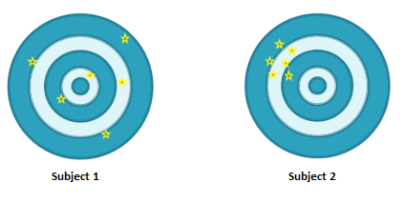
SKILL COACHING, PRACTICE & FEEDBACK
8. The following two targets were taken down after the first round of an archery competition. The results reveal that:
A. Subject 1 needs to have more blocked practice
B. Subject 2 is at the autonomous stage of learning
C. Subject 1 is at the cognitive stage
D. Subject 2 needs more random practice
ANSWER : C

Slide 10
SKILL COACHING, PRACTICE & FEEDBACK
9. When providing augmented feedback to elite baseball players, the following would bring about the largest improvements in performance:
A. Knowledge of results
B. Knowledge of performance
C. Knowledge of concentration
D. Knowledge of arousal levels
ANSWER : B

Slide 11
SKILL COACHING, PRACTICE & FEEDBACK
10. During a coaching clinic, Michael is told he will be required to practice 5 digs, followed by 5 sets and then needs to come into the net to perform 5 spikes. What type of practice is this an example of?
A. Massed
B. Random
C. Blocked
D. Distributed
ANSWER : D

