Slide 1
ACUTE & OXYGEN MECHANISMS/RESPONSES
These ppt slides have been designed to allow you to read the question, think about the responses and then on the next ‘click’ the answer will appear. Keep ‘clicking’ your way through all ten slides.
You should allow a maximum of 1 minute per slide, keep an eye on the timer provided.
Make sure you focus on the key words in the question and if any visual stimulus material (graphs, tables, etc) are provided, to understand what is being represented before considering the 4 responses provided.

Slide 2
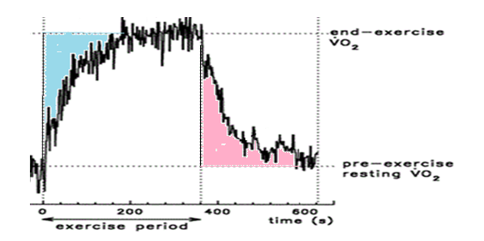
ACUTE & OXYGEN MECHANISMS/RESPONSES
1. The ‘pink’ section of the graph corresponds to :
A. PESS (post exercise steady state)
B. Oxygen deficiency
C. Oxygen deficit
D. EPOC
ANSWER : D

Slide 3
ACUTE & OXYGEN MECHANISMS/RESPONSES
2. An athlete participating in the 400m sprint would experience the following acute muscular response:
A. Increased ATP levels
B. Increased stroke volume
C. Increased a-VO2 diff
D. Increased respiratory rate
ANSWER : C

Slide 4
ACUTE & OXYGEN MECHANISMS/RESPONSES
3. During exercise, the alveoli expand and increase their surface area in order to:
A. Increase a-VO2 diff
B. Increase gaseous exchange
C. Decrease gaseous exchange
D. Decrease concentration gradient differences
ANSWER : B

Slide 5
ACUTE & OXYGEN MECHANISMS/RESPONSES
4. Which of the following statements best describes stroke volume response to exercise?
A. Stroke volume increases linearly with exercise intensity
B. Stroke has a finite capacity which is reached at maximal intensity
C. Stroke volume increases exponentially with exercise intensity
D. Stroke has a finite capacity which is reached sub-maximally
ANSWER : D

Slide 6
ACUTE & OXYGEN MECHANISMS/RESPONSES
5. H+ will accumulate during exercise if:
A. Steady state is exceeded
B. Athletes reach their LIP
C. H+ production exceeds H+ removal
D. Glycogen sparing results in ‘extra’ CHO becoming available
ANSWER : C

Slide 7
ACUTE & OXYGEN MECHANISMS/RESPONSES
6. During exercise in hot conditions, it is common to see vasodilation of blood vessels supplying the skin. This results in:
A. Higher sweat rates
B. Greater amounts of blood being shunted to the skin
C. Higher muscular heat production
D. Greater amounts of blood being shunted to the non-vital organs
ANSWER : B

Slide 8
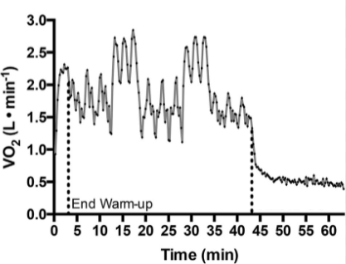
ACUTE & OXYGEN MECHANISMS/RESPONSES
7. The oxygen consumption graph reveals that:
A. Resting levels are 0.25 L/min (approx.)
B. The largest oxygen deficit occurs immediately after the warm-up
C. Oxygen demand is greatest at 17 mins (approx.)
D. Oxygen deficit occurs at 43 mins (approx.)
ANSWER : C

Slide 9
ACUTE & OXYGEN MECHANISMS/RESPONSES
8. During a maximal effort 50m freestyle swim that smashes the world record, which acute muscular response would see the greatest change when compared to resting levels?
A. ATP stores
B. PC stores
C. Glucose stores
D. Glycogen stores
ANSWER : A

Slide 10
ACUTE & OXYGEN MECHANISMS/RESPONSES
9. A marathon runner sprints to the finish line to set a new PB (personal best) time. During this final sprint they would experience:
A. Increased stroke volume
B. Increased tidal volume
C. Increased VO2 maximum
D. Increased motor unit recruitment
ANSWER : D

Slide 11
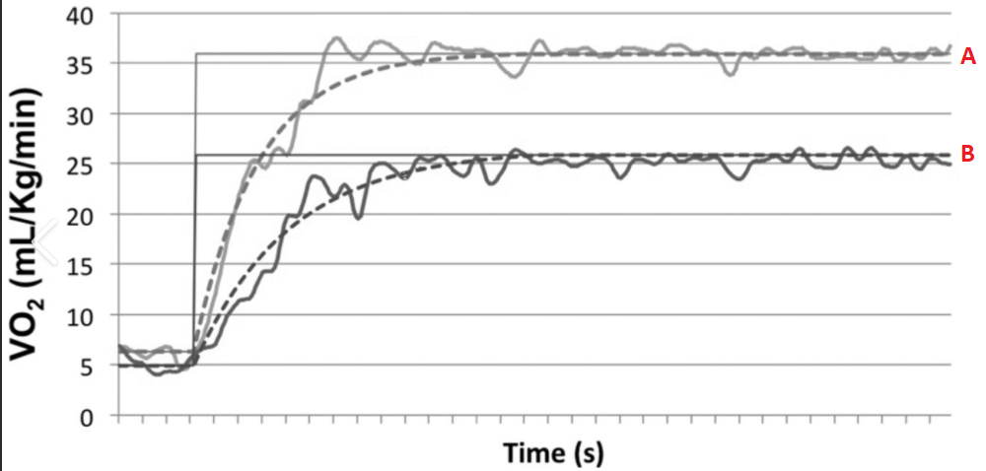
ACUTE & OXYGEN MECHANISMS/RESPONSES
10. Refer to the graph before selecting the statement that most accurately describes what is represented.
A. Athlete A and Athlete B reach steady state at the same time (approx.)
B. Athlete B is working harder than Athlete A
C. Athlete A has a higher LIP
D. Stroke volume would peak at the same time steady state starts
ANSWER : A

