Slide 1
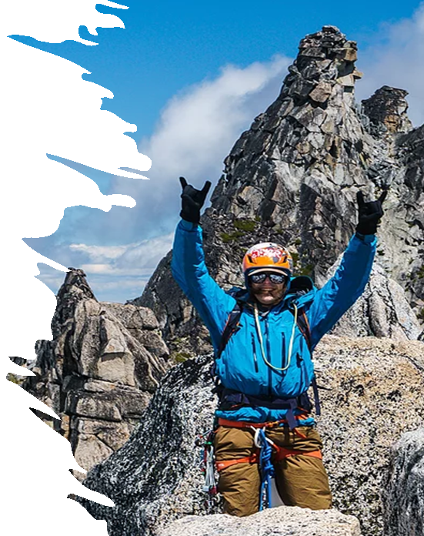
NEWTON’S 3 LAWS & PROJECTILE MOTION
These ppt slides have been designed to allow you to read the question, think about the responses and then on the next ‘click’ the answer will appear. Keep ‘clicking’ your way through all ten slides.
You should allow a maximum of 1 minute per slide, keep an eye on the timer provided.
Make sure you focus on the key words in the question and if any visual stimulus material (graphs, tables, etc) are provided, to understand what is being represented before considering the 4 responses provided.

Slide 2
NEWTON’S 3 LAWS
1. A 70 kg sprinter and an 80 kg sprinter both reach their maximal speed of 35 k/hr when they reach the ½ way stage of the 100m sprint. The 80 kg sprinter will find it harder to stop at this point because they have:
A. Longer levers (legs)
B. Increased force of gravity acting on their mass
C. Lower inertia
D. Greater momentum
ANSWER : D

Slide 3
NEWTON’S 3 LAWS
2. The following image was taken at a rowing regatta. If both teams are collectively applying the same force with their team of rowers, the team that is able to accelerate away from the others must be:
A. Lighter
B. Stronger
C. Taller (longer levers)
D. More efficient
ANSWER : A

Slide 4
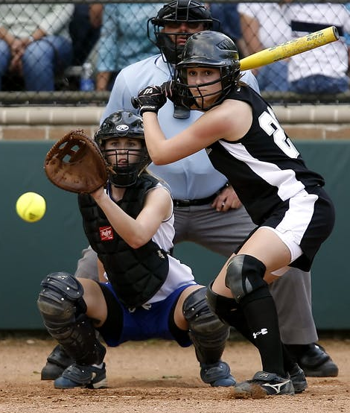
NEWTON’S 3 LAWS
3. The softball catcher in the image below uses the principle of ‘impulse’ by wearing a padded glove in an attempt to:
A. Increase the surface area the ball makes contact with
B. Increase the time over which the ball is slowed
C. Increase the ‘target zone’ for the pitcher
D. Provide and equal reaction to the action of the pitcher
ANSWER : B

Slide 5
NEWTON’S 3 LAWS
4. The moment of inertia is a measure of how much:
A. Rotation a body possesses
B. Resistance to rotation is present
C. Momentum a body can generate
D. Torque an object possesses
ANSWER : B

Slide 6
NEWTON’S 3 LAWS
5. The following is the best example of Newton’s 3rd Law of Motion in a sporting context:
A. A tennis player striking the ball ‘off-centre’ to produce a slice serve
B. A lifesaver applying force on the left side of the board resulting in it turning in this direction
C. A badminton player using as many body parts as possible whilst performing a smash in order to create the highest summation of force.
D. A volleyball player pushing downwards in an effort to leap upwards
ANSWER : D

Slide 7
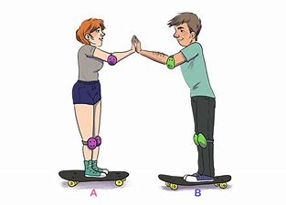
NEWTON’S 3 LAWS
6. Two skateboarders (same weight) stand opposite each other and push as hard they can against each other. The one that ends up moving further from the original starting position:
A. Applies greater force
B. Is stronger
C. Has less friction applied to their wheels
D. Experiences less displacement
ANSWER : A

Slide 8
NEWTON’S 3 LAWS
7. Impulse is best described as a:
A. Product of force and mass
B. Force applied over the shortest time possible to create acceleration
C. Change in momentum
D. Sum of moment of inertia and angular velocity
ANSWER : C

Slide 9
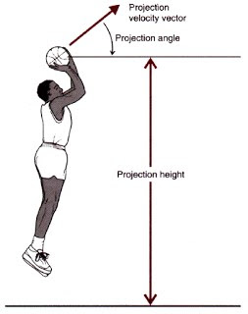
PROJECTILE MOTION
8. The following image shows a basketballer taking a ‘jump shot’. By jumping before releasing the ball, the optimal angle of release compared to taking the same shot whilst standing on the court:
A. Remains the same
B. Increases
C. Decreases
D. Shows an inverse relationship with ball velocity
ANSWER : C

Slide 10
PROJECTILE MOTION
9. The optimal angle of release in the basketball example shown is:
A. 45 degrees
B. Less than 45 degrees
C. Greater than 45 degrees
D. 90 degrees
ANSWER : C

Slide 11
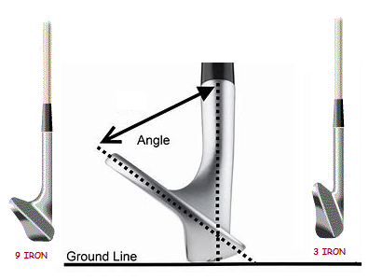
PROJECTILE MOTION
10. A golfer uses the following 2 clubs (9 iron = 45 degrees & 3 iron = 23 degrees ) to strike the ball with the same force. By using the 9 iron the ball will travel :
A. Further
B. Higher
C. Longer
D. With less torque
ANSWER : B

