Slide 1
TRAINING PRINCIPLES
These ppt slides have been designed to allow you to read the question, think about the responses and then on the next ‘click’ the answer will appear. Keep ‘clicking’ your way through all ten slides.
You should allow a maximum of 1 minute per slide, keep an eye on the timer provided.
Make sure you focus on the key words in the question and if any visual stimulus material (graphs, tables, etc) are provided, to understand what is being represented before considering the 4 responses provided.

Slide 2
TRAINING PRINCIPLES
A triple jumper changes his plyometrics training from 4 x 8 x 50cm bench blasts to 5 x 10 x 60cm bench blasts. This is an example of:
A. Overtraining
B. Progression
C. Specificity
D. Frequency
ANSWER : A

Slide 3
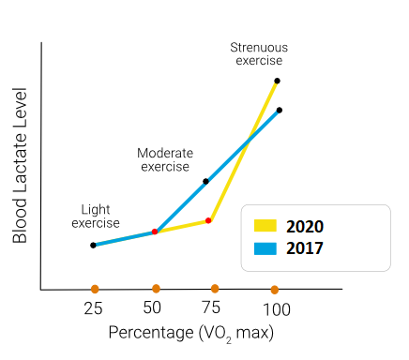
TRAINING PRINCIPLES
2. Sarah is a cross-country skier who has gradually increased her lactate threshold via continuous training over the last 3 years. This has shifted from 50% VO₂ max to 75% VO₂ max.
In order to ensure her aerobic power kept increasing over the 3 year training period, she needed to:
A. use a mix of continuous cycling, running and swimming.
B. increase her training intensity when adaptations occurred, coinciding with training becoming easier.
C. combine altitude training with sea-level training.
D. train with others to ensure she kept working hard when she felt like
giving up.
ANSWER : B

Slide 4
TRAINING PRINCIPLES
3. A triathlete wants to maintain their fitness heading into a major competition in 10-days time. They should:
A. Reduce their training from 6-days/week to 2-days/week
B. Reduce their training volume by ¼
C. Decrease their sets but increase their reps to maintain endurance
D. Maintain their training volume, but introduce variety
ANSWER : B

Slide 5
TRAINING PRINCIPLES
4. Philly and her friend Emily both decide to start training for the school’s newly advertised lacrosse team Philly has been training twice a week with her netball team whilst Emily has never trained before. If they both undertake the same training for lacrosse the following is likely to occur:
A. Emily will experience slower improvements than Philly
B. Philly will experience slower improvements than Emily
C. Emily will experience diminishing returns
D. Philly will experience overtraining
ANSWER : B

Slide 6
TRAINING PRINCIPLES
5. Which of the following training examples best highlights the principle of specificity?
A. Deciding to train with a group of team-mates to spur each other on.
B. A 400m track athlete training on sand to make the session harder.
C. A netball centre performing 7m sprints to replicate the most common sprint distance in a games analysis.
D. A marathon runner working at 70% maxHR on a treadmill for 2 hours.
ANSWER : C

Slide 7
TRAINING PRINCIPLES
6. When considering detraining:
A. Training loads need to be doubled when training recommences
B. Frequency drops from x3/week to x2/week
C. It is quicker to experience fitness loses than reversing these
D. The closer one gets to their genetic potential, the slower the rate of improvement
ANSWER : C

Slide 8
TRAINING PRINCIPLES
7. When considering progression, the following example most correctly demonstrates its application:
A. A sprinter going from 6 x 75m sprints every 2 minutes to 6 x 100m sprints every 1.5 minutes
B. A rower increasing her training on the rowing ergometer by decreasing the distance rowed, increasing the RPE, and increasing the frequency from 5 to 7 days/week
C. A hockey player increasing the activities performed in a circuit every week for the duration of a mesocycle
D. A javelin thrower going from 4 x 3 x 40kg tricep extensions to 4 x 3 x 42kg tricep extensions
ANSWER : D

Slide 9
TRAINING PRINCIPLES
8. In order to improve mitochondrial density, the following TYPE of training and TIME, will lead to the greatest increases:
A. Continuous for 30 mins
B. H.I.I.T. for 8 minutes
C. Fartlek for 20 mins
D. Continuous for 20 mins
ANSWER : A

Slide 10
TRAINING PRINCIPLES
9. A netball player wanting to ensure SPECIFICITY is being correctly applied to her training program should:
A. Mimic the W:R ratio shown in the games analysis
B. Only focus on the predominant energy system from the games analysis
C. Ensure that activities within the methods chosen replicate actions revealed by the games analysis
D. Use dynamic stretching to warm-up and an active recovery to warm-down
ANSWER : C

Slide 11
TRAINING PRINCIPLES
10. In order to break out of a training/physiological plateau, athletes should apply:
A. More load
B. Greater Intensity
C. Increased volume
D. Less rest
ANSWER : A

