Slide 1
ASSESSMENT OF FITNESS
These ppt slides have been designed to allow you to read the question, think about the responses and then on the next ‘click’ the answer will appear. Keep ‘clicking’ your way through all ten slides.
You should allow a maximum of 1 minute per slide, keep an eye on the timer provided.
Make sure you focus on the key words in the question and if any visual stimulus material (graphs, tables, etc) are provided, to understand what is being represented before considering the 4 responses provided.

Slide 2
ASSESSMENT OF FITNESS
1. A fitness test that actually assesses what it claims to assess is considered to be:
A. Accurate
B. Reliable
C. Valid
D. Consistent
ANSWER : C

Slide 3
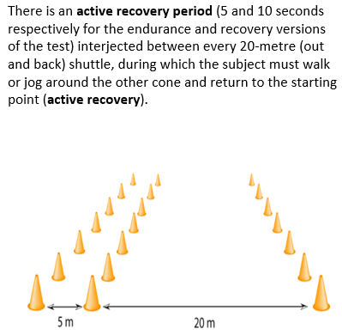
ASSESSMENT OF FITNESS
2. Which one of the following combinations best describes the fitness component being assessed, the type of test and the variable being measured or estimated?
A. Aerobic capacity / maximal / gaseous exchange
B. Aerobic power / sub-maximal / VO2 maximum
C. Muscular endurance / sub-maximal / O2 consumption
D. Aerobic endurance / maximal / a-VO2 diff
ANSWER : B

Slide 4
ASSESSMENT OF FITNESS
3. The Harvard step test :
A. Measures a person’s maximal heart rate and predicts their VO2 max
B. Predicts a person’s VO2 max based on their sub-maximal heart rate
C. Should be used by athletes whilst they are recovering injury
D. Measures muscular endurance (legs)
ANSWER : B

Slide 5
ASSESSMENT OF FITNESS
4. The following testing condition would ensure the highest reliability. Have the same:
A. Warm-up
B. Clothing
C. Diet
D. Test
ANSWER : D

Slide 6
ASSESSMENT OF FITNESS
5. Pre-exercise screening such as the PAR-Q:
A. Helps determine a participant’s readiness for fitness testing
B. Protects both the test administrator and the person doing the test
C. Ensures confidentiality is kept
D. Allows any questions and concerns to be addressed prior to testing
ANSWER : A

Slide 7
ASSESSMENT OF FITNESS
6. Which one of the following socio-cultural factors needs to be considered prior to selecting a fitness test:
A. Test validity
B. Where the test is scheduled to occur
C. Mixed gender testing
D. Consistency of testing protocols
ANSWER : C

Slide 8
ASSESSMENT OF FITNESS
7. A laboratory test, when compared to a field test will provide:
A. Greater validity
B. A physiological estimate with high correlation
C. Actual physiological data
D. Less need for recovery
ANSWER : C

Slide 9
ASSESSMENT OF FITNESS
8. Informed consent should be conducted before running any fitness test to allow:
A. Potential ‘testee’ risks to be identified and discussed
B. The person conducting the test to get to know the ‘testee’ better
C. The ‘testee’ to indemnify the test administrator should injury occur
D. Suitability of the ‘testee’ to undertake the test to be assessed
ANSWER : A

Slide 10
ASSESSMENT OF FITNESS
9. An appropriate test to assess muscular power (legs) is the:
A. Margaria-Kalamen stair sprint test
B. 1 RM leg press
C. Basketball throw
D. Standing Lieutenant Jump
ANSWER : A

Slide 11
ASSESSMENT OF FITNESS
10. A field test such as the Yo-Yo Intermittent Test has the following advantage when compared to a laboratory test:
A. Low cost (equipment, personnel, etc..)
B. Many people can be tested at the same time
C. Quick recovery time and ability to do another test(s)
D. All of the above
ANSWER : D

