Slide 1
MOMENTUM, MOTION & MAINTAINING BALANCE
These ppt slides have been designed to allow you to read the question, think about the responses and then on the next ‘click’ the answer will appear. Keep ‘clicking’ your way through all ten slides.
You should allow a maximum of 1 minute per slide, keep an eye on the timer provided.
Make sure you focus on the key words in the question and if any visual stimulus material (graphs, tables, etc) are provided, to understand what is being represented before considering the 4 responses provided.

Slide 2
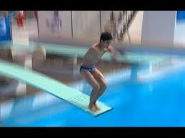
MOMENTUM, MOTION & MAINTAINING BALANCE
1. The diver is about to grab his knees just after leaving the springboard in an effort to move as many body parts close to his axis of rotation. This will:
A. Increase the summation of momentum
B. Decrease the moment of inertia
C. Increase the angular momentum
D. Decrease the angular velocity
ANSWER : B

Slide 3
MOMENTUM, MOTION & MAINTAINING BALANCE
2. When taking a soccer throw in both feet must be in contact with the ground. By dragging the back foot forwards, players can:
A. Generate greater angular momentum
B. Create greater sequential acceleration of body parts
C. Increase the amount of mass moving in the desired direction of travel
D. Decrease the likelihood of losing balance
ANSWER : C

Slide 4
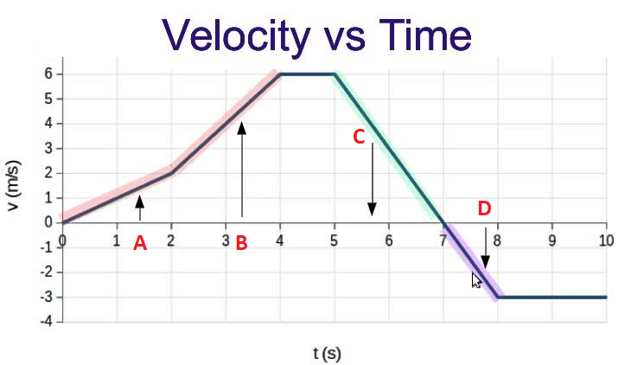
MOMENTUM, MOTION & MAINTAINING BALANCE
3. Which of the following statements is most accurately demonstrated in the velocity graph. The performer:
A. Is moving fastest at B
B. Is moving slower at D than C
C. Has greater acceleration at B than A
D. Reaches maximum velocity at B
ANSWER : C

Slide 5
MOMENTUM, MOTION & MAINTAINING BALANCE
4. A tennis player at the autonomous stage can serve at higher velocity than someone at the associative stage because they have greater:
A. Momentum
B. Sequential acceleration of body parts involved in the serve
C. Lever length at point of contact with the ball
D. Balance
ANSWER : B

Slide 6
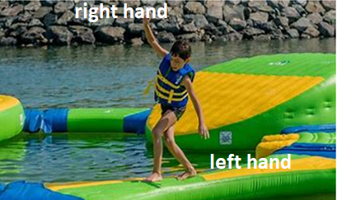
MOMENTUM, MOTION & MAINTAINING BALANCE
5. The following image was taken at a water park. In an attempt to stop falling into the water, the child needs to:
A. Swing their left hand toward their right hand
B. Lower their centre of gravity
C. Increase their base of support
D. Swing their right hand towards their left hand
ANSWER : A

Slide 7
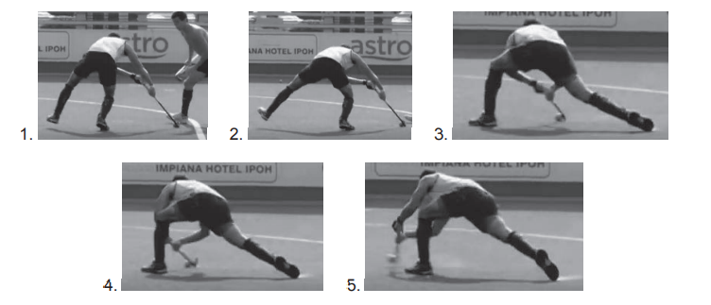
MOMENTUM, MOTION & MAINTAINING BALANCE
6. In the photo depicting a hockey push, the player is MOST stable at:
A. 1
B. 2
C. 3
D. 4
ANSWER : C

Slide 8
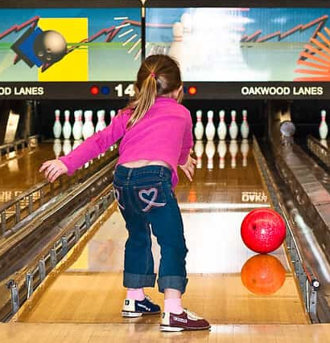
MOMENTUM, MOTION & MAINTAINING BALANCE
7. The following image shows a young girl bowling with the assistance of bumpers which stop the ball from travelling in the gutter and ensures it travels all the way down to the pins. Which statement is most accurate:
A. Using a heavier ball will allow it to have greater momentum
B. Leaning backwards will increase her balance
C. The bumpers will decrease the friction on the ball
D. Following through will increase the momentum put on the ball
ANSWER : D

Slide 9
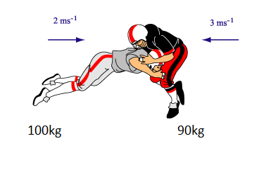
MOMENTUM, MOTION & MAINTAINING BALANCE
8. In the following collision between these two gridiron players the :
A. Momentum before the collision is greater than that after the collision
B. Lighter player has greater momentum
C. Heavier player has greater momentum
D. Momentum after the collision is less than that before the collision
ANSWER : B

Slide 10
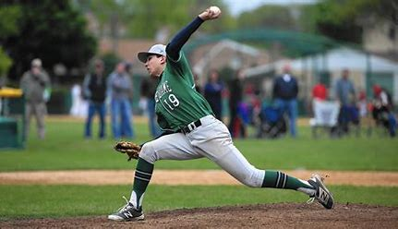
MOMENTUM, MOTION & MAINTAINING BALANCE
9. The baseball pitcher in the photo steps forwards before releasing the ball in order to increase:
A. Momentum
B. Inertia
C. Balance
D. Height of release
ANSWER : A

Slide 11
MOMENTUM, MOTION & MAINTAINING BALANCE
10. The greatest summation of momentum best occurs when:
A. The sum of all body parts is equal to the parts that contribute to the overall momentum.
B. As many body parts contribute to movement in correct sequence as the previous heavier body part transfers momentum as it reaches maximum velocity.
C. The moment of inertia is decreased as much as possible allowing angular velocity to be maximised so angular momentum can also be optimised.
D. Angular velocity is multiplied by moment of inertia
ANSWER : B

