Slide 1
ENERGY SYSTEMS I
These ppt slides have been designed to allow you to read the question, think about the responses and then on the next ‘click’ the answer will appear. Keep ‘clicking’ your way through all ten slides.
You should allow a maximum of 1 minute per slide, keep an eye on the timer provided.
Make sure you focus on the key words in the question and if any visual stimulus material (graphs, tables, etc) are provided, to understand what is being represented before considering the 4 responses provided.

Slide 2
ENERGY SYSTEMS I
1. During a 30 second maximal sprint whilst performing the Wingate cycle ergometer test:
A. PC would be totally depleted
B. The anaerobic glycolysis system kicks in around the 5 second stage of the test after the PC system has peaked.
C. The anaerobic glycolysis system would provide most of the ATP
D. The aerobic energy system would provide the 2nd most amount of ATP after the PC system
ANSWER : C

Slide 3
ENERGY SYSTEMS I
2. The final sprint in a 1500m track event to break a world record would have most of the ATP produced by the :
A. ATP energy system
B. ATP-PC energy system
C. Anaerobic glycolysis energy system
D. Aerobic energy system
ANSWER : D

Slide 4
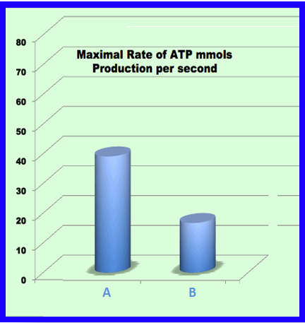
ENERGY SYSTEMS I
3. Refer to the graph below to answer the following question on sources of ATP
A. A= anaerobic glycolysis B = aerobic glycolysis
B. A = aerobic glycolysis B = anaerobic glycolysis
C. A = anaerobic glycolysis B = PC breakdown
D. A = Fat B = CHO
ANSWER : A

Slide 5
ENERGY SYSTEMS I
4. Peta performs 8 x 7-second sprints with 23 seconds rest (W:R = 1:3). The final sprint would have most of the ATP being produced by:
A. ATP energy system
B. ATP-PC energy system
C. Anaerobic glycolysis energy system
D. Aerobic energy system
ANSWER : C

Slide 6
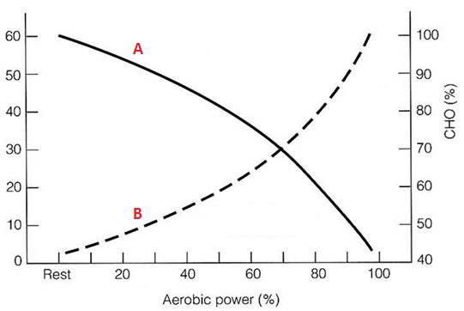
ENERGY SYSTEMS I
5. In the graph below, A represents:
A. Carbohydrates
B. Fats
C. Proteins
D. Creatine Phosphate
ANSWER : B

Slide 7
ENERGY SYSTEMS I
6. When considering energy system interplay, greater involvement from the aerobic energy system would lead to :
A. A decrease in rate of energy production
B. An increase in rate of metabolic by-product production
C. A decrease in the amount of ATP produced
D. An increase in the contribution from the anaerobic energy systems
ANSWER : A

Slide 8
ENERGY SYSTEMS I
7. During a 200m sprint, the amount of muscle ATP at the end of the sprint would be:
A. Similar to what it was at the start of the race
B. Significantly less than what it was at the start of the race
C. Half the original amount (start of race)
D. More than what it was at the start of the race
ANSWER : A

Slide 9
ENERGY SYSTEMS I
8. Anaerobic glycolysis:
A. Results in heat, H2O & CO2 being produced
B. Produces more ATP than aerobic glycolysis
C. Results in pyruvate resynthesis into glycogen
D. Produces ATP at a faster rate than aerobic glycolysis
ANSWER :

Slide 10
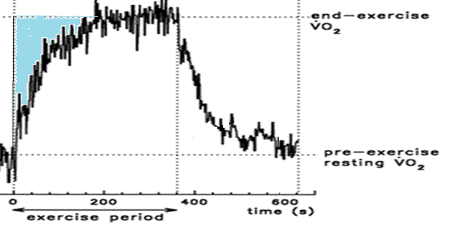
ENERGY SYSTEMS I
9. The highlighted section of the graph below indicates significant use of which energy system(s)
A. PC
B. PC & Anaerobic glycolysis
C. Aerobic
D. Aerobic & Anaerobic glycolysis
ANSWER : B

Slide 11
ENERGY SYSTEMS I
10. During EPOC featuring a passive recovery, the following occurs at the fastest rate:
A. ATP resynthesis
B. H+ oxidation
C. PC resynthesis
D. CHO replenishment
ANSWER : C

