Slide 1
SKILL LEVELS & INFLUENCING FACTORS
These ppt slides have been designed to allow you to read the question, think about the responses and then on the next ‘click’ the answer will appear. Keep ‘clicking’ your way through all ten slides.
You should allow a maximum of 1 minute per slide, keep an eye on the timer provided.
Make sure you focus on the key words in the question and if any visual stimulus material (graphs, tables, etc) are provided, to understand what is being represented before considering the 4 responses provided.

Slide 2
SKILL LEVELS & INFLUENCING FACTORS
1. Surfing is a popular recreation and sport many Australians participate in. In terms of classification it would be which type of motor skill:
A. Fine
B. Closed
C. Open
D. Continuous
ANSWER : C

Slide 3
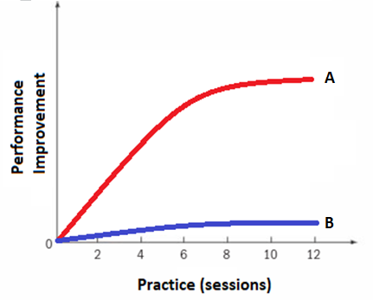
SKILL LEVELS & INFLUENCING FACTORS
2. Consider the graph:
Line B would most likely represent a performer who is at the following stage of learning:
A. Cognitive
B. Associative
C. Autonomous
D. Beginner
ANSWER : C

Slide 4
SKILL LEVELS & INFLUENCING FACTORS
3. Proprioception is a form of internal feedback which would be most effectively used by
A. A netballer playing in the National league
B. An 8-year old participating in an Auskick AFL session
C. A gamer competing in the ESports Call of Duty Championship
D. Someone competing in a darts competition (indoors)
ANSWER : A

Slide 5
SKILL LEVELS & INFLUENCING FACTORS
4. A leading soccer coach has improved the performance of players by introducing regular training sessions that focus of improving concentration and arousal control. This is an example of what type of constraint:
A. Environmental
B. Task
C. Psychological
D. Individual
ANSWER : D

Slide 6
SKILL LEVELS & INFLUENCING FACTORS
5. You have volunteered to coach the Year 4 soccer team, with students not having had much exposure to this sport other than a few “kick-ball” games in their class. In order to achieve skill improvements in the group, you decide to:
A. Put padding on the goals to minimise the risk of injury
B. Focus on individual skill improvements rather than team skills
C. Take the students through massed practice due to the direct relationship between practice time and skill improvement
D. Spend half the training session with the students running laps so their aerobic endurance improves and they don’t fatigue during a match.
ANSWER : B

Slide 7
SKILL LEVELS & INFLUENCING FACTORS
6. When teaching a 7-year old the basketball lay-up (on a lowered backboard and ring), the most effective coaching strategy would be to:
A. Show them video footage of an NBL player performing the skill so they know what it looks like and can then try to reproduce it
B. Encourage the player to use both hands so they can approach the ring from either the left side or right side of the court
C. Teach the skill as a ‘whole’ because it involves momentum which is vital to the skill being executed successfully
D. Break the skill down into its parts and encourage them add them together as they improve.
ANSWER : D

Slide 8
SKILL LEVELS & INFLUENCING FACTORS
7. Nguyen’s friends only participate in sport when they have P.E. classes. He is a promising swimmer who has been selected to represent Victoria at the National Championships. In terms of skill development, Nguyen’s peers have contributed to:
A. Him turning to swimming because it does not involve as many skills as other sports such as soccer, basketball, tennis, hockey, etc..
B. Nguyen not likely to practice skills involving eye hand co-ordination contributing to lower performance levels in activities requiring this
C. His above average Mathematical ability due to increased study time due to not participating in sports other than swimming
D. A direct linear relationship between practice and performance
ANSWER : B

Slide 9
SKILL LEVELS & INFLUENCING FACTORS
8. The following characteristics:
improved consistency/less errors
less attentional demands
improved self-correction
would most likely be seen in a performer at the following stage of learning:
A. Cognitive
B. Associative
C. Autonomous
D. Automotive
ANSWER : B

Slide 10
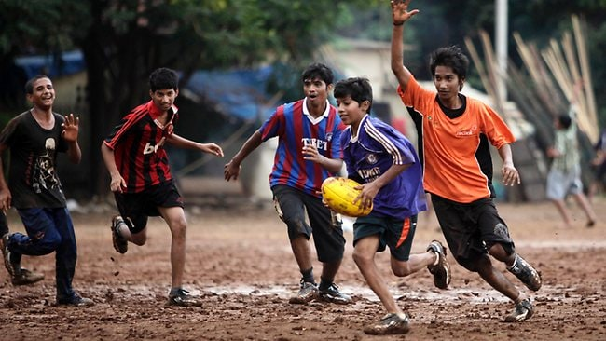
SKILL LEVELS & INFLUENCING FACTORS
9. A group of AFL players visited a Malaysian village during their off-season and gifted a school group a football for them to train and play with. It is unlikely they will reach the same skill levels as same-aged youth back in Australia because they have:
A. Limited practice opportunities
B. Low levels of parental support
C. No media coverage of AFL
D. Lower socio-economic status
ANSWER : A

Slide 11
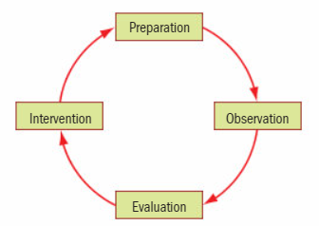
SKILL LEVELS & INFLUENCING FACTORS
10. The following is a schematic representation of the 4 parts of a qualitative analysis. Feedback is provided at what stage
A. Preparation
B. Observation
C. Evaluation
D. Intervention
ANSWER : D

