Slide 1
ENERGY SYSTEMS II
These ppt slides have been designed to allow you to read the question, think about the responses and then on the next ‘click’ the answer will appear. Keep ‘clicking’ your way through all ten slides.
You should allow a maximum of 1 minute per slide, keep an eye on the timer provided.
Make sure you focus on the key words in the question and if any visual stimulus material (graphs, tables, etc) are provided, to understand what is being represented before considering the 4 responses provided.

Slide 2
ENERGY SYSTEMS II
1. The energy system that has the highest capacity is the :
A. ATP energy system
B. ATP-PC energy system
C. Anaerobic glycolysis energy system
D. Aerobic energy system
ANSWER : D

Slide 3
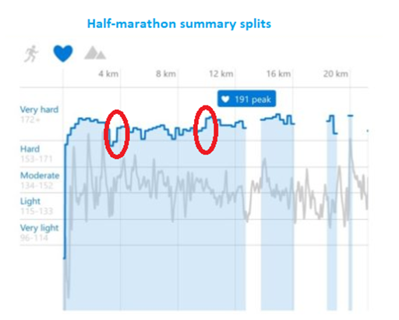
ENERGY SYSTEMS II
2. During the marathon, the circled sections of the race represents increased running speed required to keep up with a break-away group at the front of the race. This means there would be increased contribution at these points from the:
A. ATP energy system
B. PC energy system
C. Anaerobic glycolysis energy system
D. Aerobic energy system
ANSWER : C

Slide 4
ENERGY SYSTEMS II
3. A person performing the 60-sec maximal push up test will have the greatest amount of ATP produced from the:
A. ATP energy system
B. PC energy system
C. Anaerobic glycolysis energy system
D. Aerobic energy system
ANSWER : C

Slide 5
ENERGY SYSTEMS II
4. Carbohydrates are our preferred exercise fuels because they can:
A. Produce ATP anaerobically AND aerobically
B. Be stored at the muscles AND liver in large amounts
C. Have a high rate of ATP production if required
D. All of the above
ANSWER : D

Slide 6
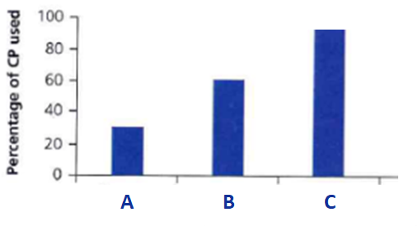
ENERGY SYSTEMS II
5. Considering fuel use for 3 different athletic events (high jump; shot put; & 400m), event “B” is most likely to be:
A. High Jump
B. Shot Put
C. 400m
D. Active recovery from all 3 events
ANSWER : A

Slide 7
ENERGY SYSTEMS II
6. The world record for the 3000m m belongs to Junixa Wang and was set in 1973 with a time of just over 8 minutes. The approximate contribution from the aerobic energy system would be:
A. 80%
B. 60%
C. 40%
D. 20%
ANSWER : A

Slide 8
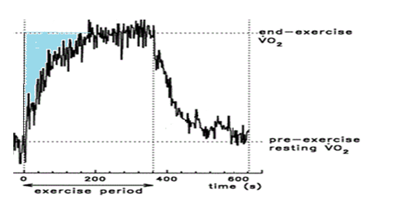
ENERGY SYSTEMS II
7. From the 200 – 400 second stage of this activity the energy system providing most of the ATP would be the:
A. ATP energy system
B. PC energy system
C. Anaerobic glycolysis energy system
D. Aerobic energy system
ANSWER : D

Slide 9
ENERGY SYSTEMS II
8. Steph starts a 20 minute workout on a treadmill and the speed is set at 10 kph. As she increases the speed of the treadmill, her use of:
A. Carbohydrates and fats will remain the same
B. Carbohydrates will increase whilst use of fats decreases
C. Fats will increase whilst use of carbohydrates decreases
D. Creatine phosphate will increase whilst carbohydrates decreases
ANSWER : B

Slide 10
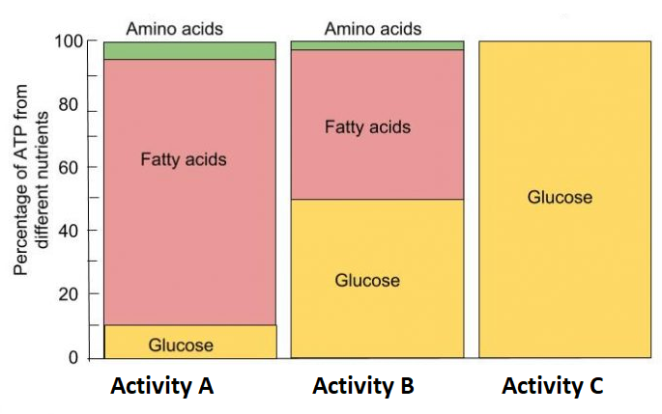
ENERGY SYSTEMS II
9. Consider the fuel usage in the 3 examples below and select the best match:
A. Activity A = 100m sprint
B. Activity B = 10,000m track event
C. Activity C = 200m sprint
D. Activity A = Marathon
ANSWER : C

Slide 11
ENERGY SYSTEMS II
10. The fitness component that would rely upon the anaerobic glycolysis system the most would be the:
A. ATP energy system
B. PC energy system
C. Anaerobic glycolysis energy system
D. Aerobic energy system
ANSWER : C

