Slide 1
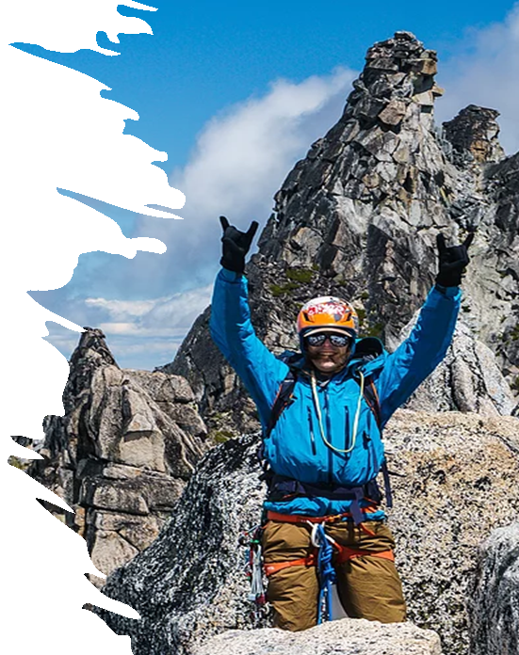
TRAINING METHODS
These ppt slides have been designed to allow you to read the question, think about the responses and then on the next ‘click’ the answer will appear. Keep ‘clicking’ your way through all ten slides.
You should allow a maximum of 1 minute per slide, keep an eye on the timer provided.
Make sure you focus on the key words in the question and if any visual stimulus material (graphs, tables, etc) are provided, to understand what is being represented before considering the 4 responses provided.

Slide 2
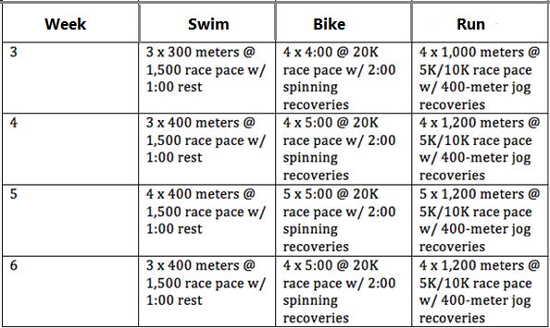
TRAINING METHODS
1. The following program considers a 4-week block for a triathlete. When considering the swimming, the method chosen represents:
A. Continuous
B. Fartlek
C. Intermediate interval
D. Long Interval
ANSWER : D

Slide 3
TRAINING METHODS
2. When considering the triathlete’s training, progression has been applied during week 5 by:
A. Increasing the sets
B. Increasing the intensity
C. Decreasing the rest
D. Increasing the frequency
ANSWER : A

Slide 4
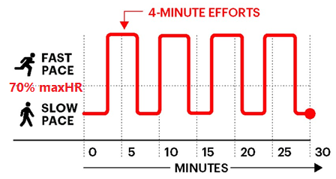
TRAINING METHODS
3. The training outline below best represents the following training method:
A. Fartlek
B. Continuous
C. H.I.I.T.
D. Long Interval
ANSWER : C

Slide 5
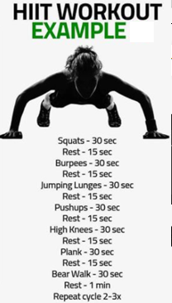
TRAINING METHODS
4. The following is NOT a good example of a HIIT workout because the:
A. Rest period is too short
B. Activities are multimodal
C. The intensity of the ‘Bear Walk’ is too low
D. Number of sets is too low (needs to be 20 mins)
ANSWER : B

Slide 6
TRAINING METHODS
5. Jolanda Neff won the women’s mountain bike event at the Tokyo Olympics in a time of 1:15. 46 by just over 1 minute from her team-mate Sina Frei. They both would most likely undertake the following type of training in an effort to maintain their aerobic power:
A. HIIT
B. Long Interval
C. Continuous
D. Fartlek
ANSWER : D

Slide 7
TRAINING METHODS
6. Dynamic stretching is favoured by elite athletes before training and competitions because it
A. has the lowest risk of injury.
B. best prepares the body by using muscles likely to be used in these settings.
C. co-ordinates the cardiorespiratory and muscular systems.
D. allows the neuromuscular systems to take joints through their fullest range of motion whilst simulating game movements.
ANSWER : D

Slide 8
TRAINING METHODS
7. The resistance training program provided has 2 exercises that have an (*) applied to them. It is likely the fitness component being targeted by these two exercises is:
A. Muscular hyperbolism
B. Muscular strength
C. Muscular power
D. Muscular endurance
ANSWER : C

Slide 9
TRAINING METHODS
8. The following circuit would be most likely used for the following sport?
A. Basketball
B. Hockey
C. Badminton
D. Water Polo
Exercise Station | 45 sec work : 45 sec rest
1. Modified pull-ups | Comments: RPE : 9 5 min break between sets 3 sets
2. 5m sprints (walk back & repeat)
3. Medicine ball floor slams
4. 3m side-shuffle between 2 cones
5. Single arm 10 overhead tennis ball throws against wall
6. Single leg step ups
ANSWER : C

Slide 10
TRAINING METHODS
9. The following is summary of a track athlete’s training, with runs conducted at 80%maxHR. It is an example of:
A. Short Interval
B. Intermediate interval
C. Long Interval
D. High Intensity Interval Training.
Rep | Work (sec) | Rest (sec)
1 | 60 | 30
2 | 90 | 40
3 | 120 | 50
4 | 150 | 60
5 | 120 | 50
6 | 90 | 40
ANSWER : C

Slide 11
TRAINING METHODS
10. Fartlek training would be highly recommended for athletes who are essentially involved in extended (40+ mins) sporting competitions where:
A. The aerobic energy system provides most of the energy, but there are times where the intensity exceeds the lactate threshold
B. The athlete has the motivation to complete the whole session above the lactate threshold
C. Periods of work are followed by periods of rest throughout the competition/activity
D. The intensity tends to remain constant and within the aerobic training zone
ANSWER : A

